Slide 1

Data Mining NFL player performance
Samit Patel, Chris Frederick,
Andrew Taylor, Tom Brown

Slide 2
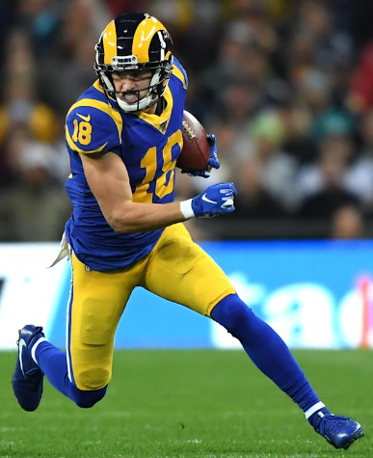
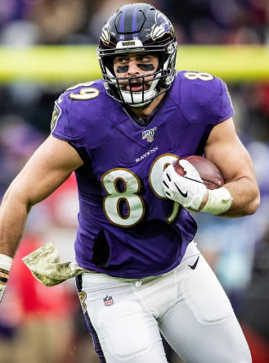
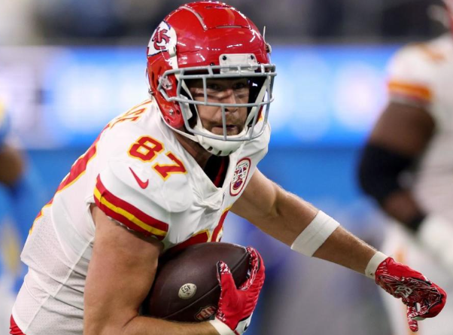
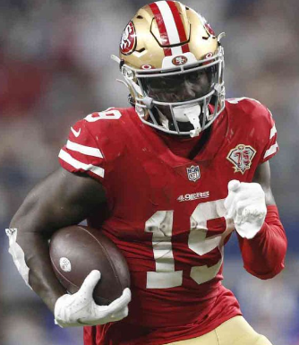
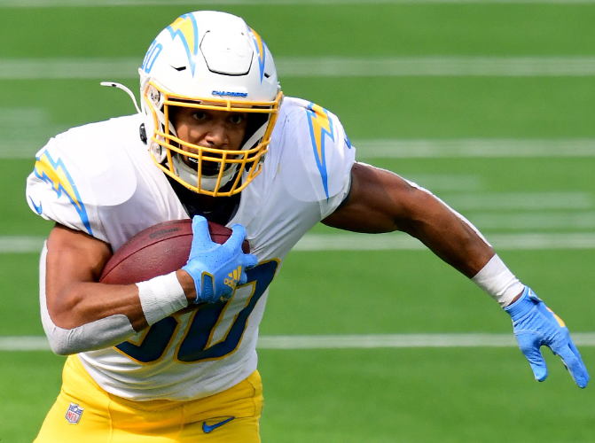
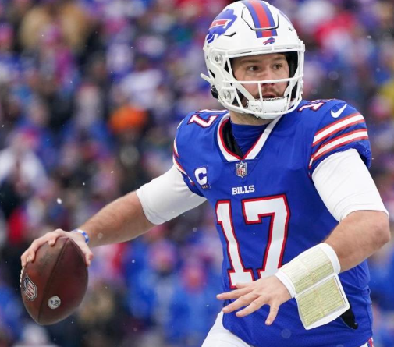
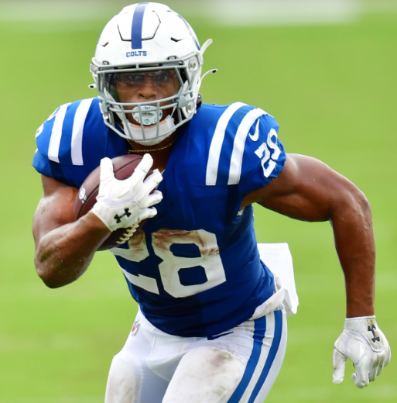
Objective
Analysis tools for fantasy football predictions
Predict fantasy point production
Identify breakout players
Breakout definition
1(from 19)
1 (from 4)
2 (from 1)
2 (from 93)
2 (from 28)
1(from 2)
1 (from 7)

Slide 3

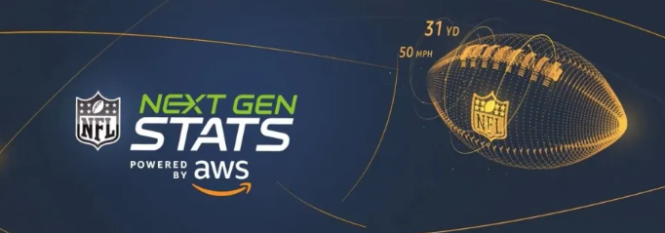
Challenges
Dimensionality
Unpredictability – injuries, trades, suspensions
Team momentum
Effect of coaches

Slide 4
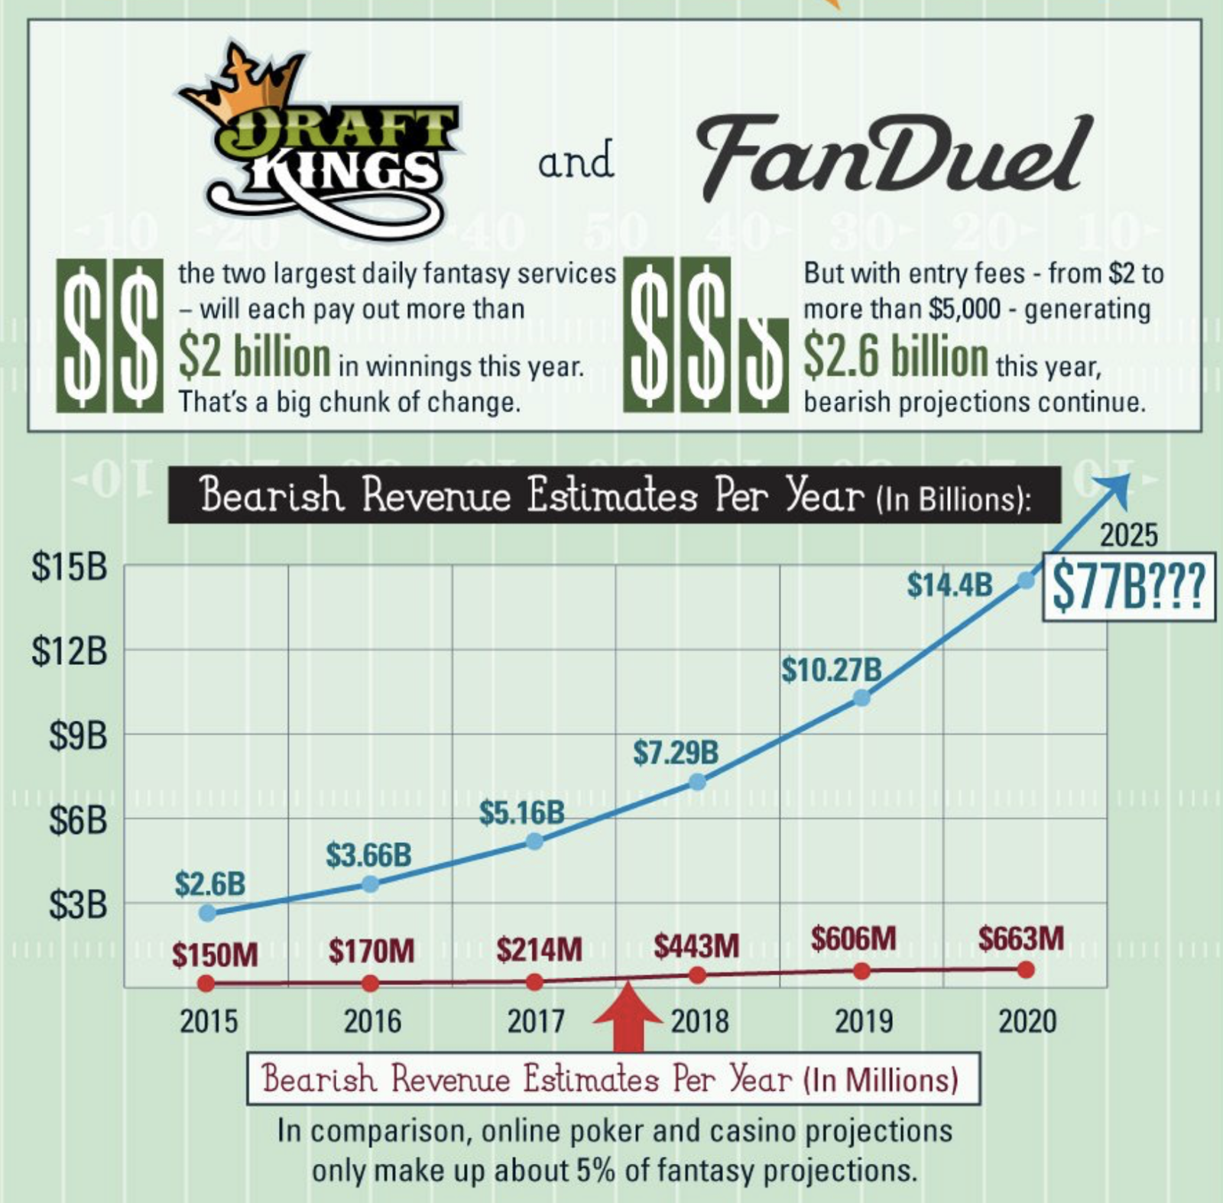
Market Size
~$18 Billion market in 2021
~$9 Billion for NFL
~57 Million users
~40 Million users for NFL

Slide 5
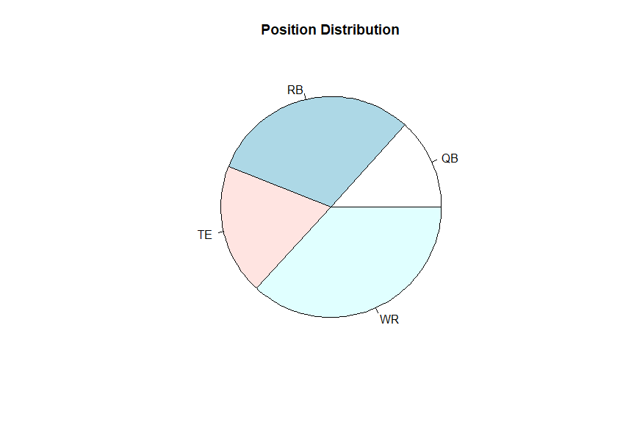
Dictionary
WR - Wide Receiver
QB – Quarter Back
RB – Running Back
TE – Tight End

Slide 6
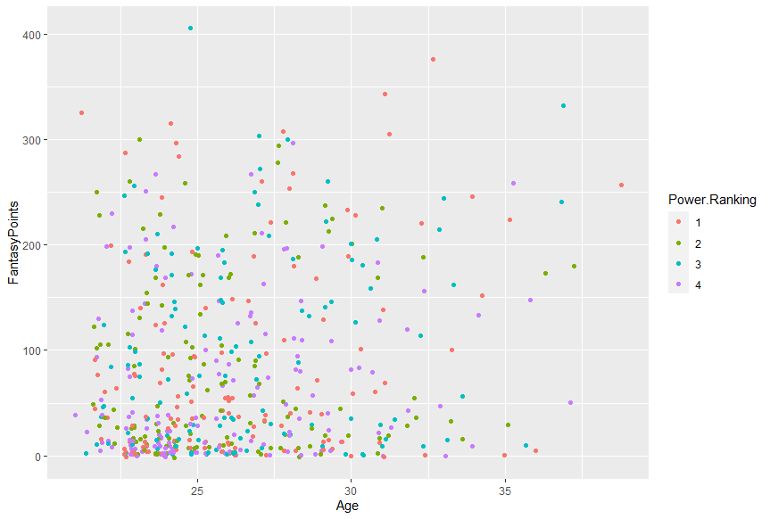

Slide 7
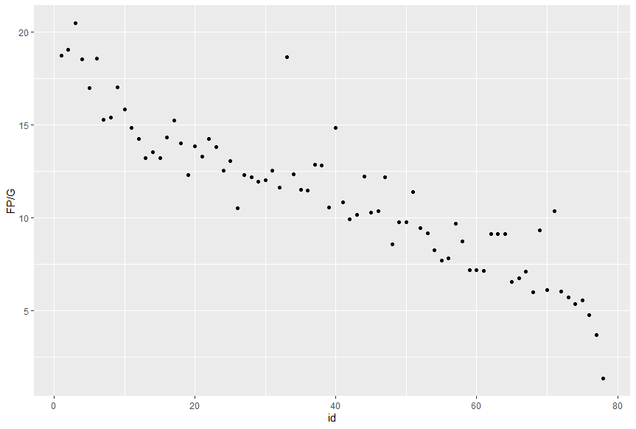
Average Points/Game for Top 80 Players with Highest Season Totals

Slide 8
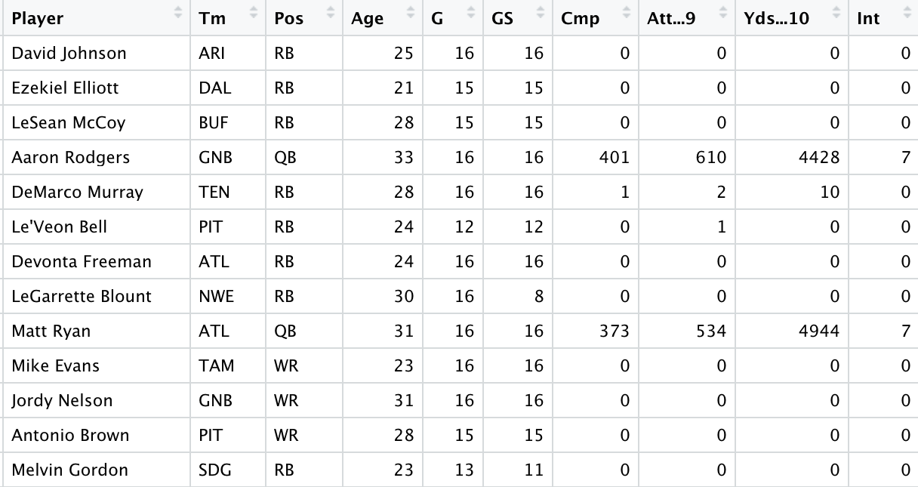
Process
Original Data Set (28 attributes)
Place all eligible(started 8 or more games) WRs into tiers based on average fantasy points per game
Place the teammates of these WRs into tiers based on average points per game
Merge data to create data frame with WR and their teammates all on single rows
Subset data for modeling

Slide 9
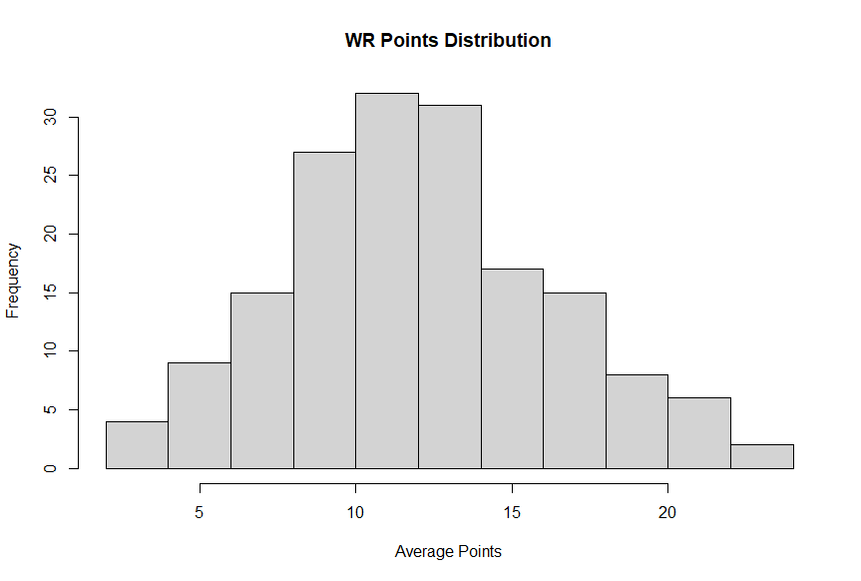
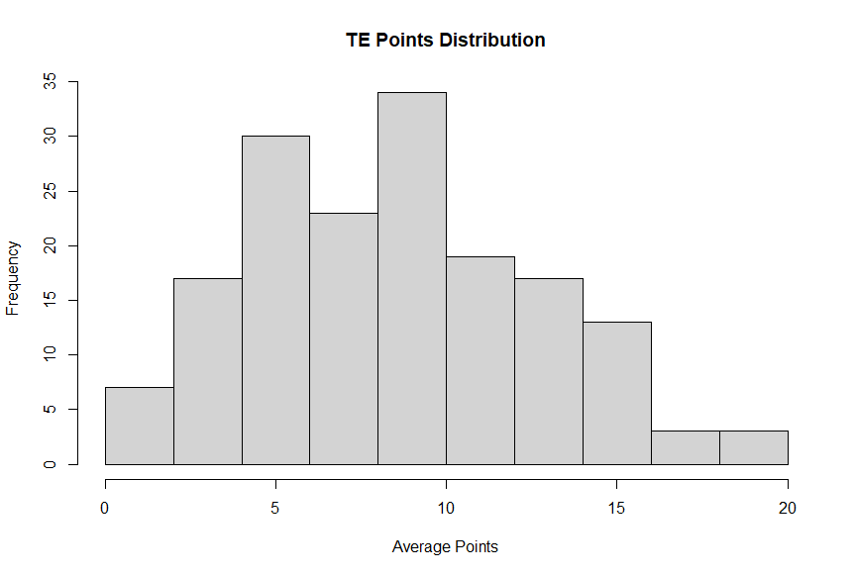
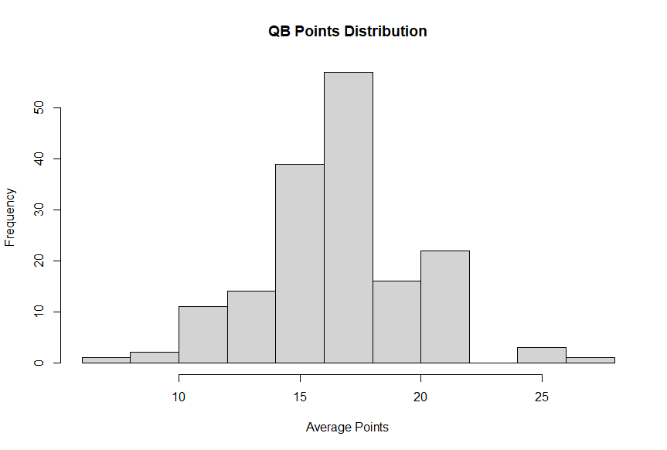
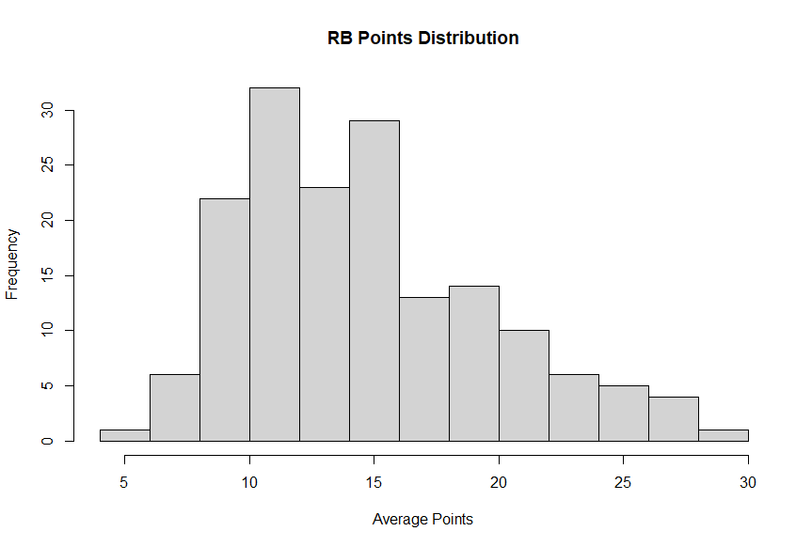

Slide 10
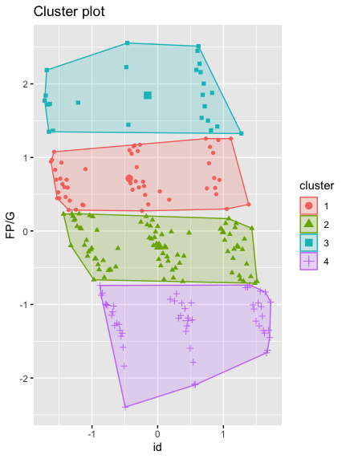
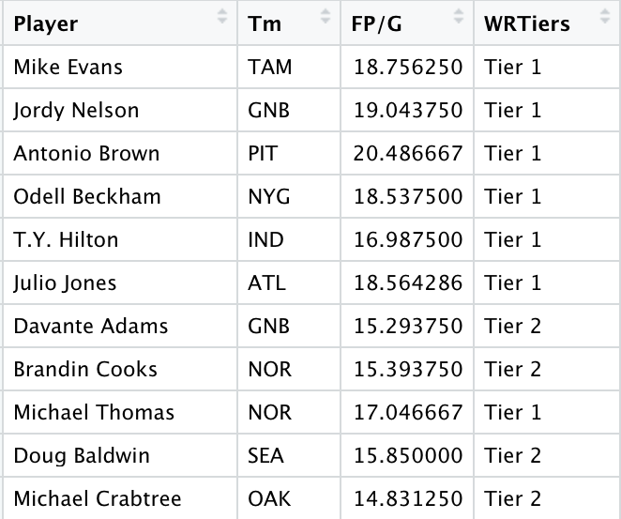
WR Tiers
Used k means clustering to create tiers
Tier 1 values (16.3 +)
Tier 2 values (12.2 - 16.2)
Tier 3 values (8.19 - 12.1)
Tier 4 values (0 - 8.18)

Slide 11
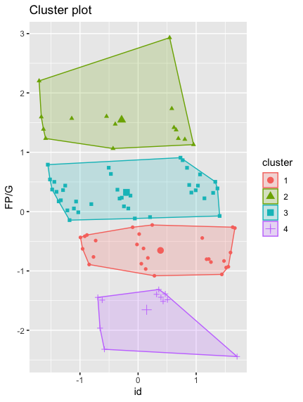
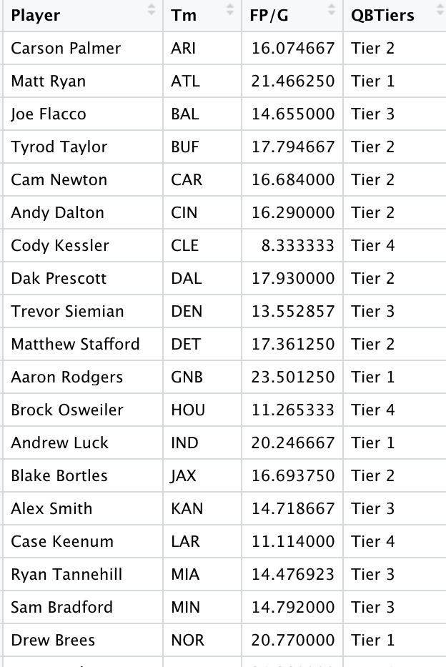
QB Tiers
Tier 1 (19.3 +)
Tier 2 (15.5 - 19.2)
Tier 3 (11.8 - 15.4)
Tier 4 (0 - 11.7)

Slide 12
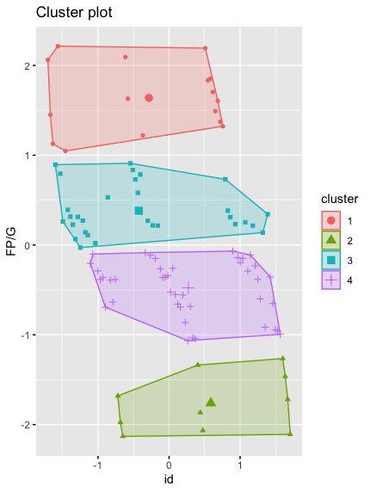
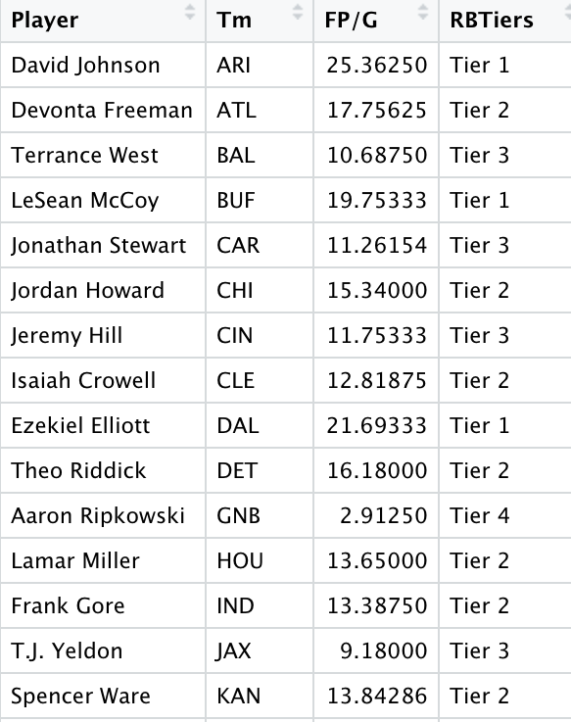
RB Tiers
Tier 1 (18.5 +)
Tier 2 (12.7 - 18.4)
Tier 3 (5.42 - 12.6)
Tier 4 (0 - 5.41)

Slide 13
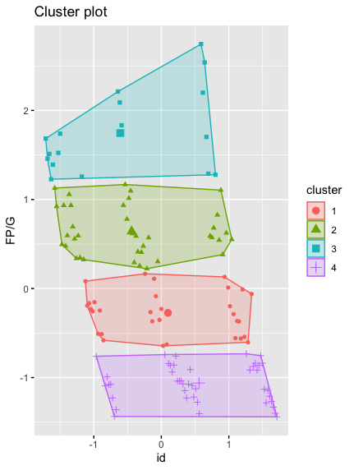
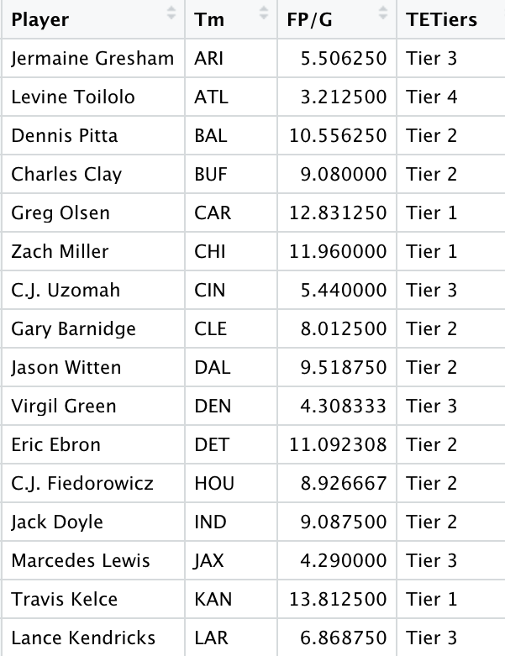
TE Tiers
Tier 1 (11.7 +)
Tier 2 (7.24 - 11.6)
Tier 3 (3.34 - 7.23)
Tier 4 (0 - 3.33)

Slide 14
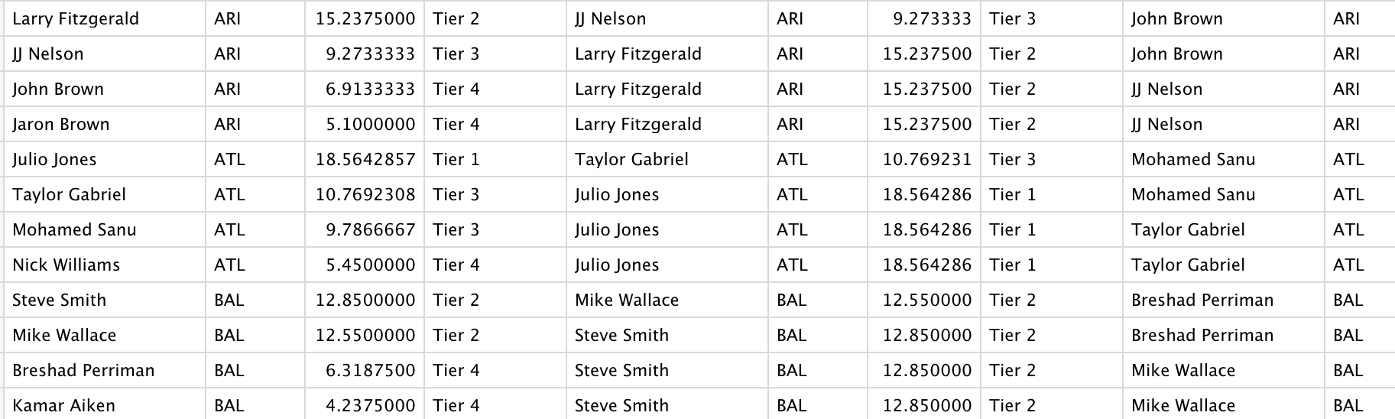
WR Teammates
We took 3 of the next best WRs on the team and placed them with our data

Slide 15
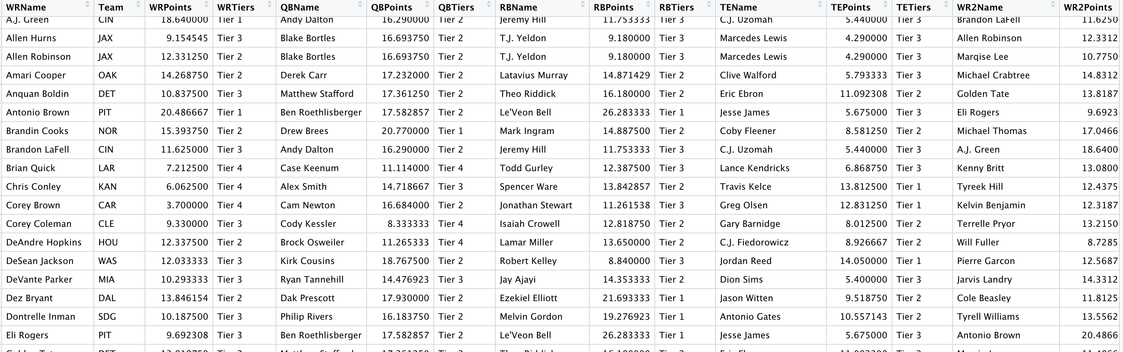
Final Data set

Slide 16
Variables Used for Classification and Prediction
Models – SVM (Linear Kernel), SVM (Polynomial Kernel), KNN
Label – WR Tiers
Predictors – QB Points, RB Points, TE Points, WR2 Points, WR3 Points, WR4 Points
Models - Naïve Bayes(Holdout Test), Naïve Bayes (Cross Validation) , Random Forest
Label – WR Tiers
Predictors – QB Tiers, RB Tiers, TE Tiers, WR2 Tiers, WR3 Tiers, WR4 Tiers

Slide 17
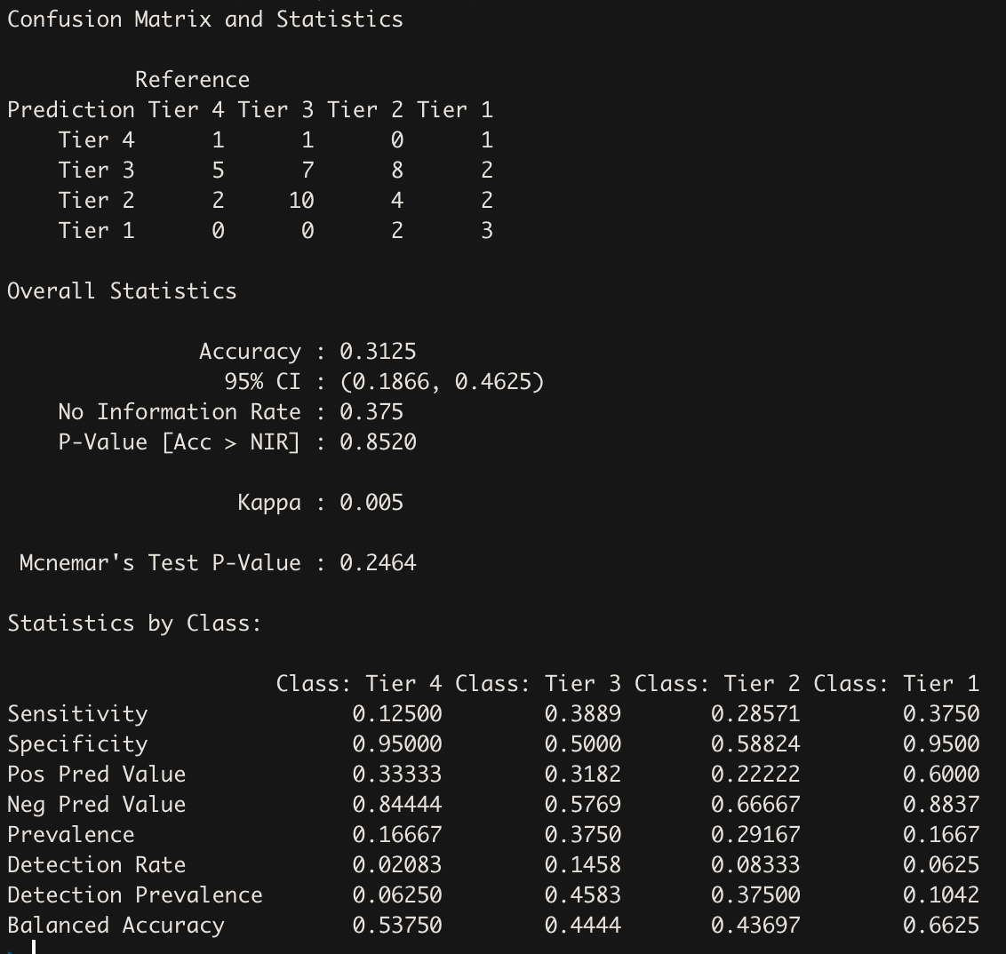
NaÏve Bayes (Holdout Test, p = 0.7)
With Naïve Bayes, we were able to yield a 31.25% accuracy. The upper end of our confidence interval is 46.25%
Ranks 4th among all models

Slide 18
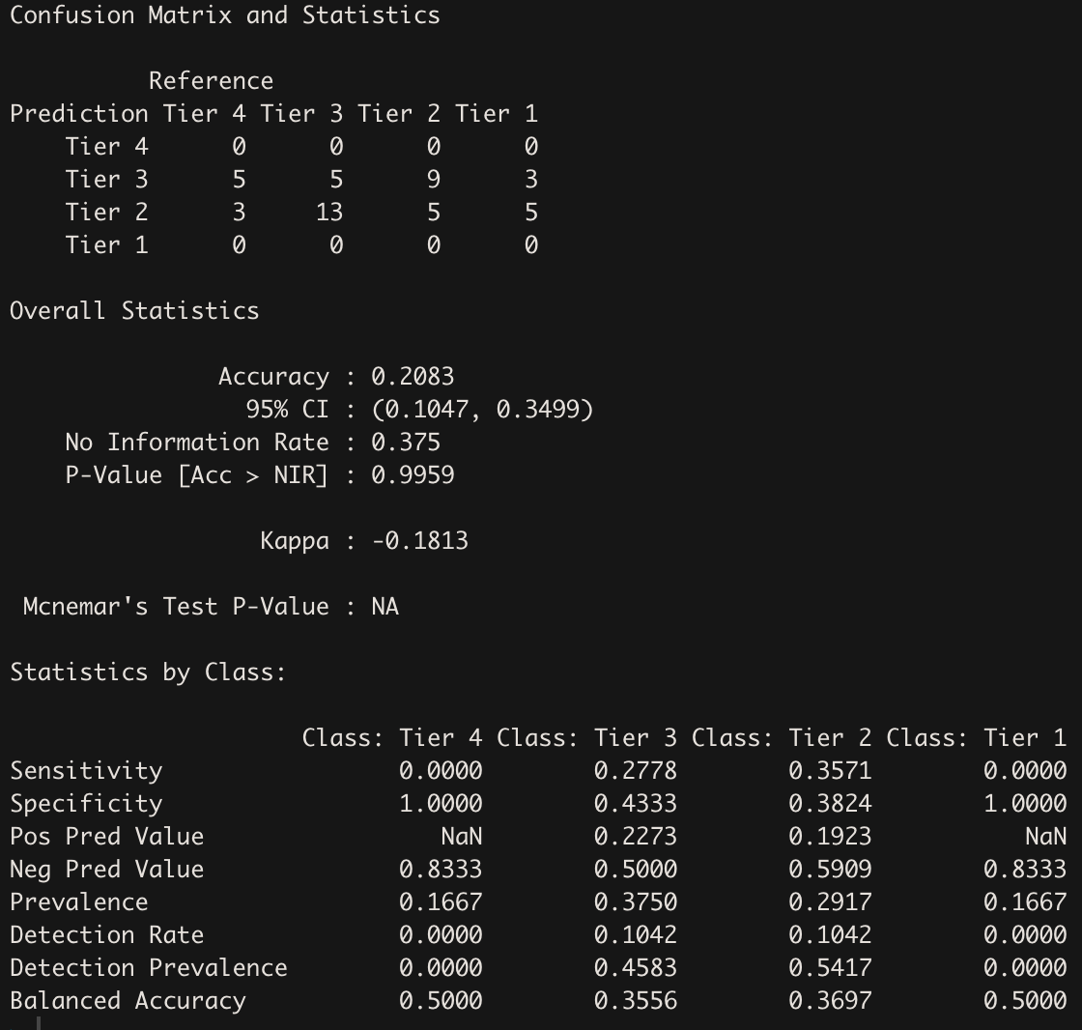
NaÏve Bayes With Cross Validation
We ran the same analysis but set the method equal to cross validation (cv). We can see that this gave us a lower accuracy percentage, with an accuracy of 20.83%, and an upper limit of 34.99%. This particular method doesn’t inspire the most confidence.
Ranks 6th among all models

Slide 19
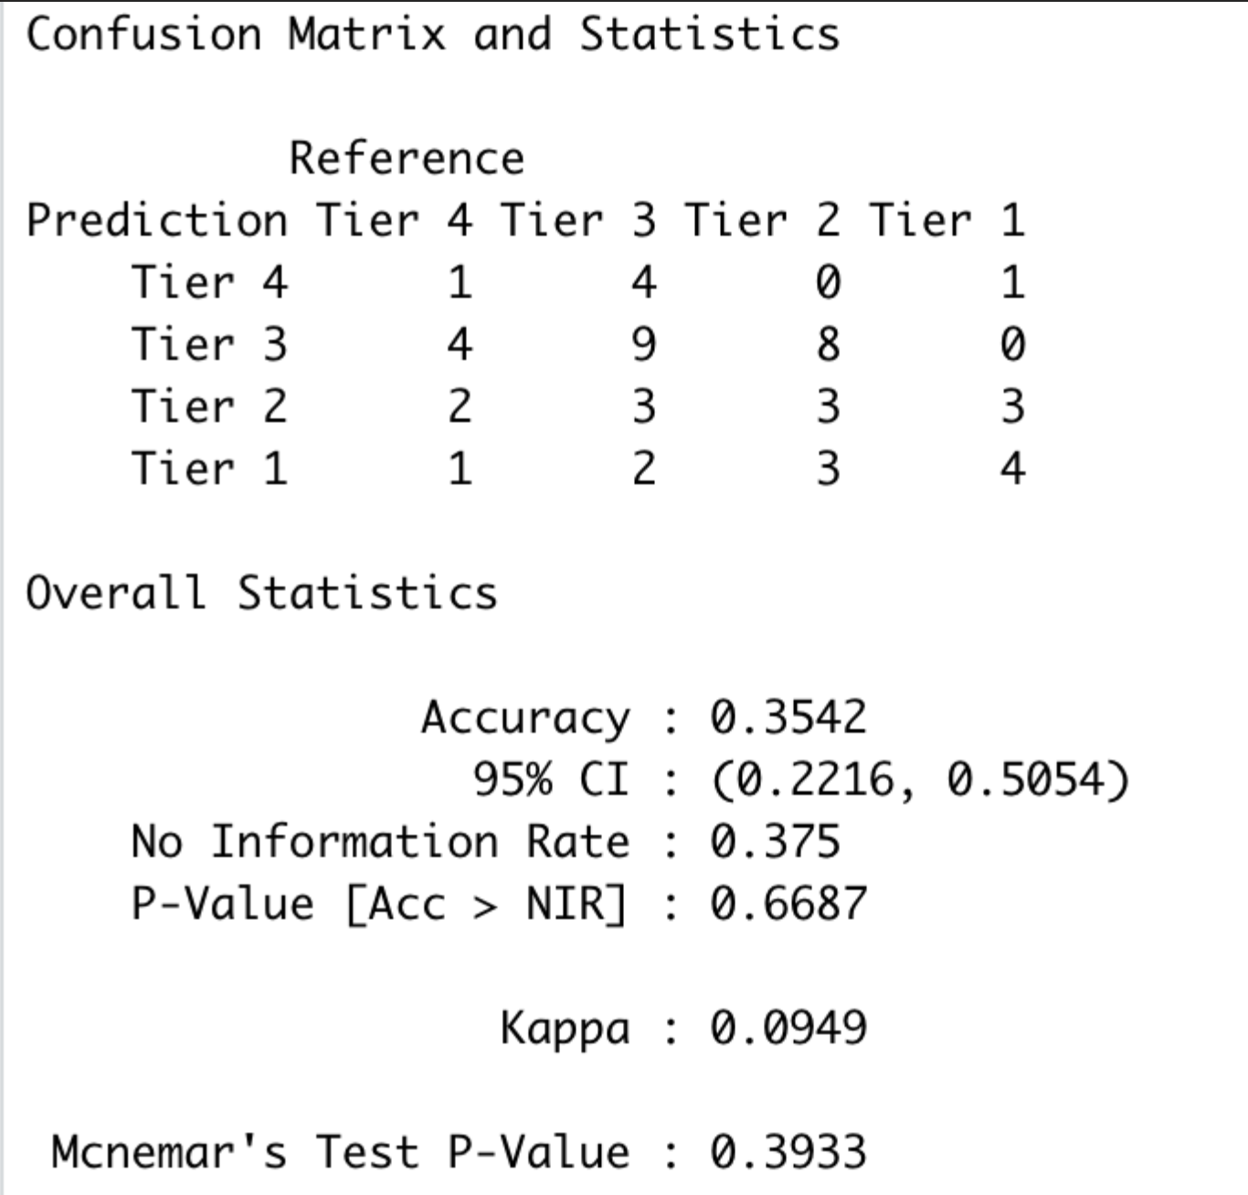
Random Forest
This model’s accuracy came in at roughly 35.42%.
Ranks 3rd among all models

Slide 20
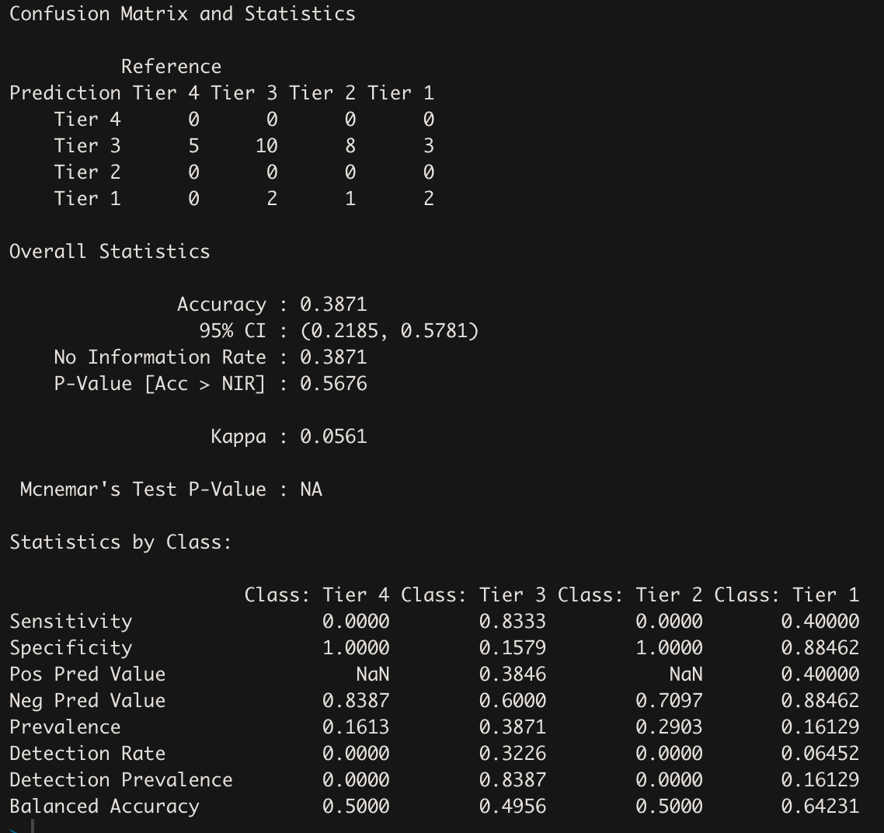
SVM (Linear Kernel)
Linear SVM yielded an accuracy of 38.71% with an upper confidence interval of 57.81%
Ranks 2nd among all models

Slide 21
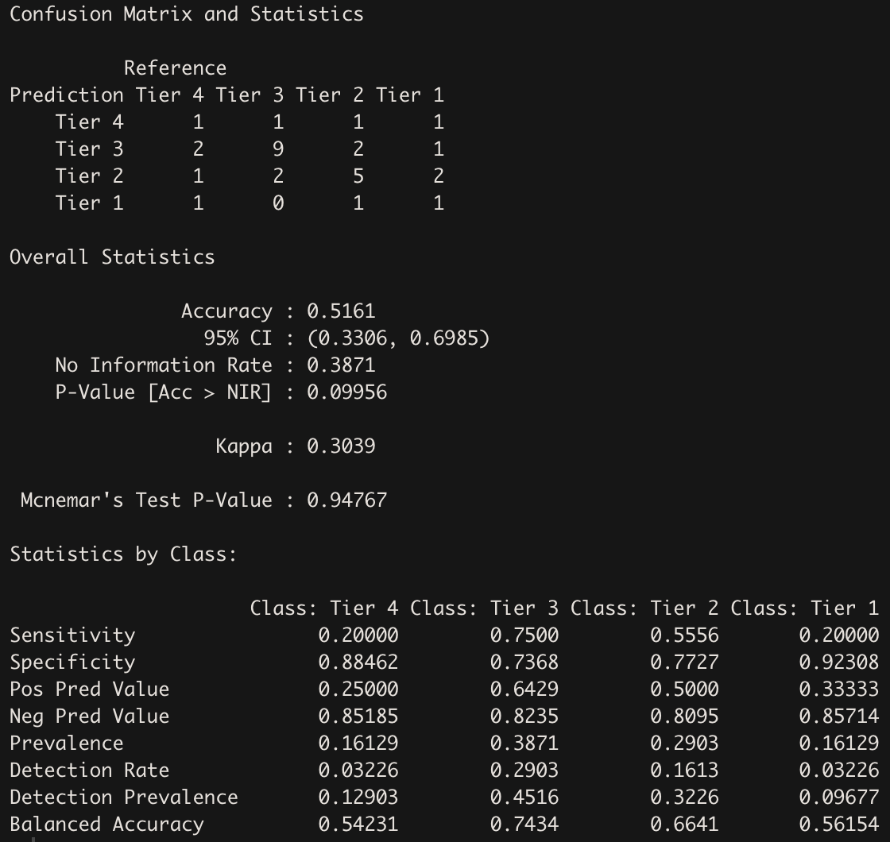
SVM (Polynomial Kernel)
Results were even further improved with an accuracy of 51.61% and an upper confidence of 69.85%.
Ranks 1st among all models

Slide 22
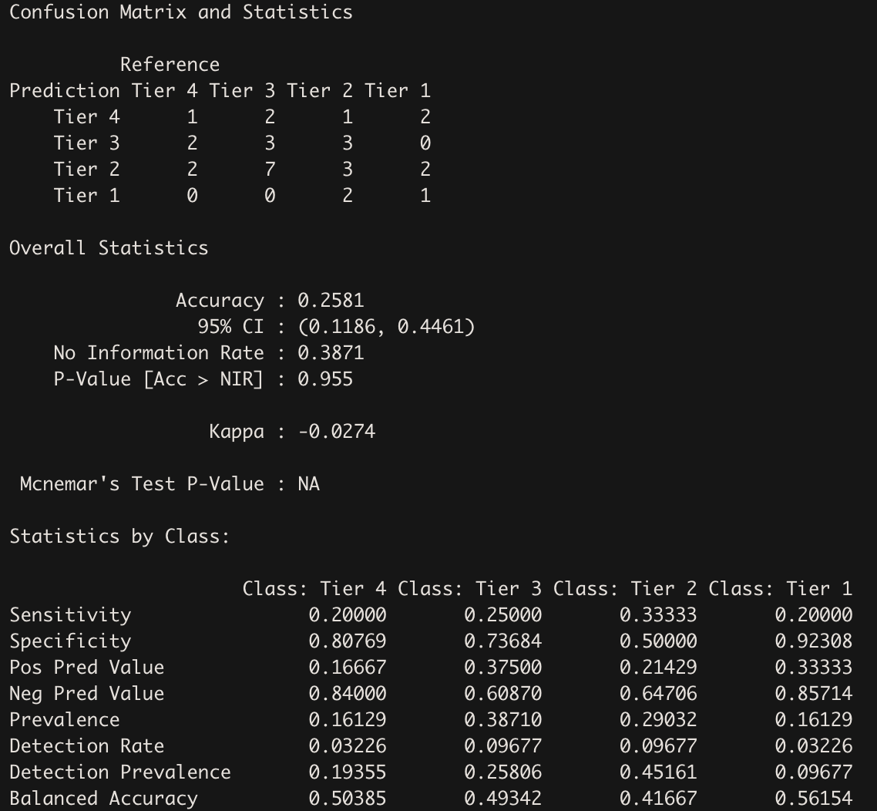
K-nearest neighbor
The results from KNN yielded a lower accuracy compared to both SVM models with only 25.81% accuracy.
Ranks 5th among all models

Slide 23
Conclusions
The final result of this analysis yielded positive results.
The best way to predict successful fantasy tiers is by using the average fantasy points.

Slide 24
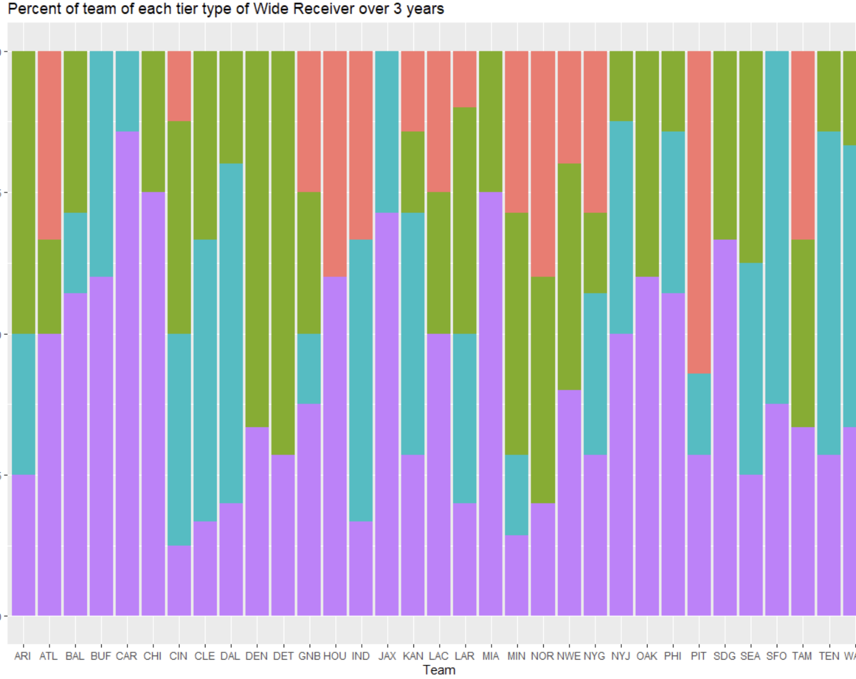
Additional Analyses
One thing to make note of is the additional analyses and results that can spin off this.
This can potentially predict overall team success.
Teams with more tier 1 players generally played worse

Slide 25
Next Improvements to Model
Increase dimensionality to strengthen model
Coaching effectiveness
Injuries (past and current)
Information about opposing team each week
Play calling percentage
Time of possession
Location of game
Temperature and weather conditions
NFL combine statistics, player height and weight
Referee statistics
Create framework to automatically update models with new data
Create framework to remove junk data from model in cases of cheating or PED use

